Slide 1

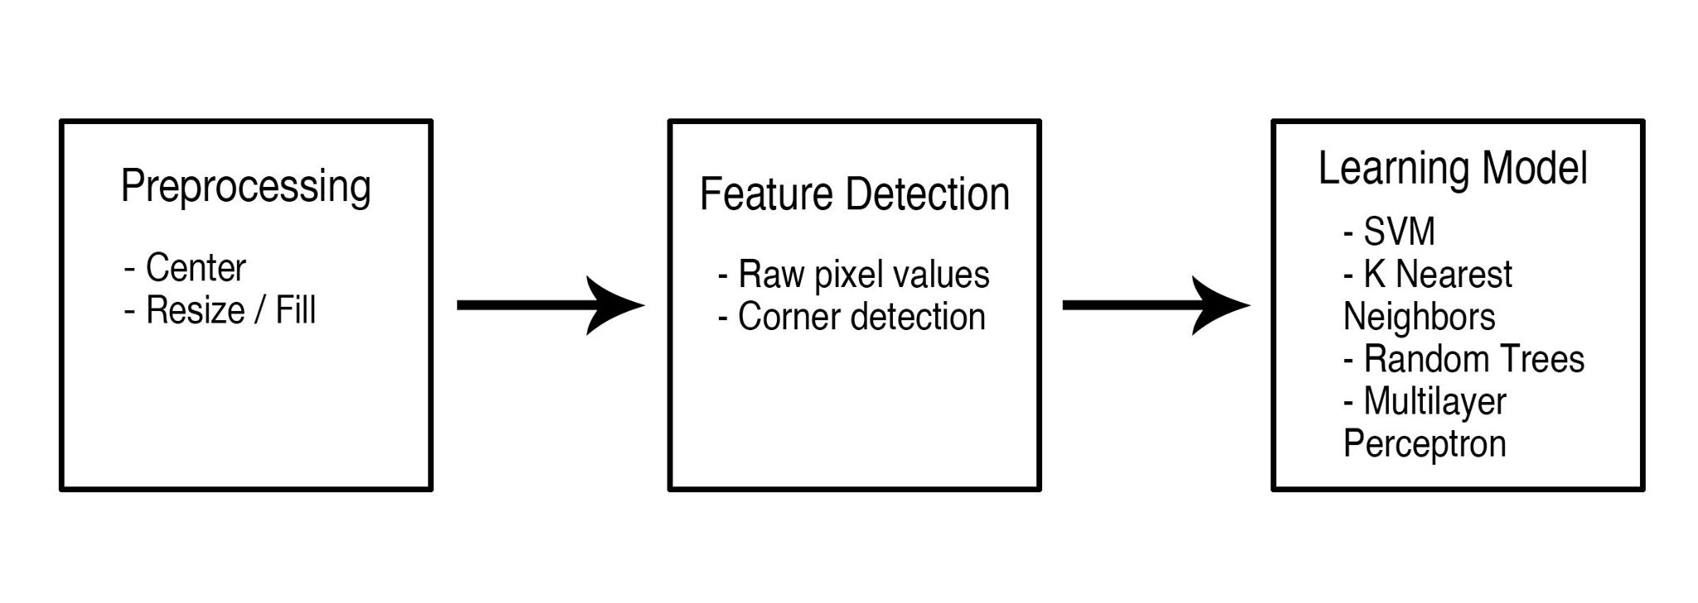



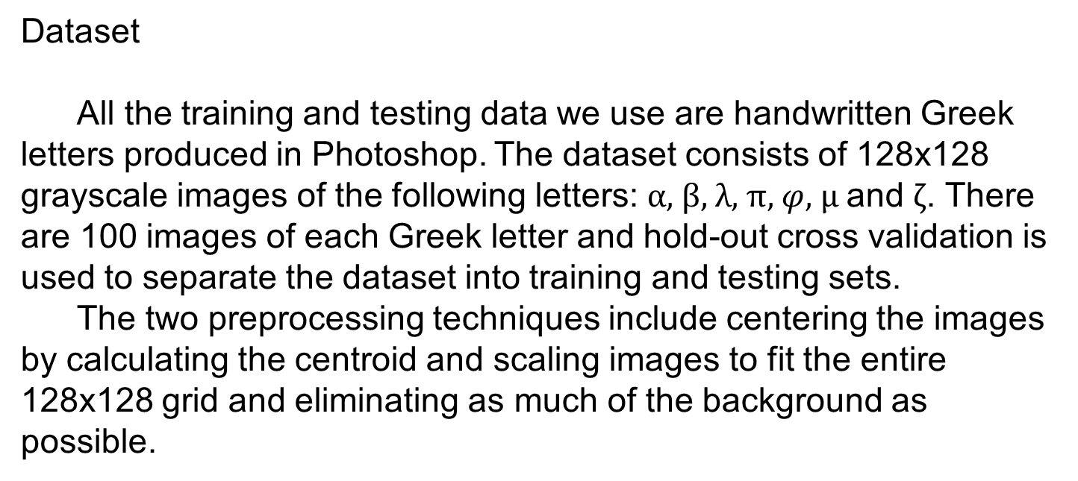
On the Recognition of Handwritten Math Equations
Maximillian Wang, Quan Nguyen, Le Cheng Fan
Problem
Typesetting mathematical equations can be an arduous process that often results in nested code that is hard to edit. We attempt to solve this problem by employing machine learning tools to detect handwritten math symbols and output their LaTeX equivalents. Although extensive research has been conducted on handwritten recognition, there is not a consensus on feature selection. We will test various feature extraction techniques and learning models to find a combination that recognizes math symbols with the lowest error. The models that we consider include SVM, K-nearest neighbors, random trees and multilayer perceptron (MLP)
Pipeline
We run our handwritten symbols through a three-step process in order to produce an optimal output. The first step is to put the image through some form of preprocessing in order to “normalize” the images and reduce variations between inputs. Next, we perform some sort of feature detection algorithm – in our case, either using a vector of pixel values or detected corners in the image. Finally, we input this feature vector into a machine learning algorithm such a support vector machine or a random forest.
Dataset
All the training and testing data we use are handwritten Greek letters produced in Photoshop. The dataset consists of 128x128 grayscale images of the following letters: $α$, $β$, $λ$, $π$, $φ$, $μ$ and $ζ$. There are 100 images of each Greek letter and hold-out cross validation is used to separate the dataset into training and testing sets.
The two preprocessing techniques include centering the images by calculating the centroid and scaling images to fit the entire 128x128 grid and eliminating as much of the background as possible.
Raw Data
Centered
Resized
References
A. Graves, et. al. A Novel Connectionist System for Improved Unconstrained Handwriting Recognition. IEEE Transactions on Pattern Analysis and Machine Intelligence, vol. 31, no. 5, 2009.
Ciresan, Dan, Ueli Meier, and Jurgen Schmidhuber. "Multi-column Deep Learning Neural Networks for Image Classification." IEEE Conference on Computer Vision and Pattern Recognition (2012): 3642-649. IEEE. Web.
Hsu, Chih-Wei, and Chih-Jen Lin. "A Comparison of Methods for Multiclass Support Vector Machines." IEEE Transactions on Neural Networks 13.2 (2002): 415-25. Web.
Knerr, S., L. Personnaz, and G. Dreyfus. "Single-layer Learning Revisited: A Stepwise Procedure for Building and Training a Neural Network."Springer 68 (1990): 41-50. Web.
Liu, Cheng-Lin, Kazuki Nakashima, Hiroshi Sako, and Hiromichi Fujisawa. "Handwritten Digit Recognition: Investigation of Normalization and Feature Extraction Techniques." Pattern Recognition 37.2 (2004): 265-79. Web.
Models
The two best models for this type of machine learning problem
are:
Future
Our future goal is to use our handwriting classification pipeline in a full transcription system. The final system should be able to read in a handwritten math equation, process it to classify each symbol, and then output LaTeX code corresponding to the written equation. In the long run we envision this system as a helpful tool for math and science students to use in their classes and make assignments easier for instructors to grade. It will also allow us to digitize older scientific publications.

